Slide 1

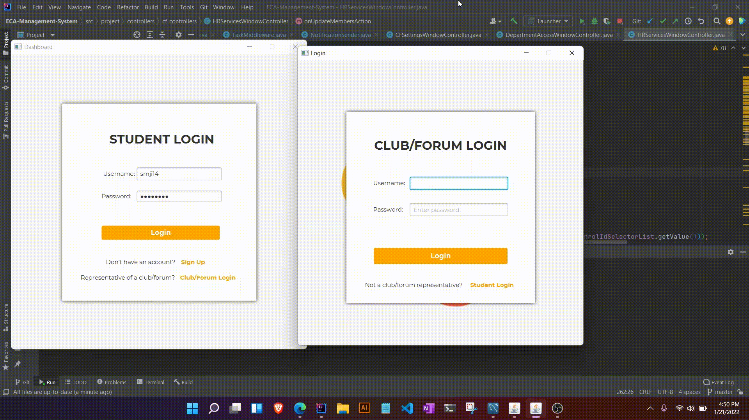
ECMS
DESKTOP
Course Name: Advanced OOP Laboratory
Course Code: CSE 2118/CSI 124
Created by:
S M Jishanul Islam, 011 201 024
Sadia Ahmmed, 011 201 146
Sahid Hossain Mustakim, 011 201 274
Course Faculty:
Subangkar Karmakar Shanto,
Lecturer
Department of Computer Science & Engineering,
United International University

Slide 2
TABLE OF CONTENTS
01
02
INTRODUCTION
THE PROBLEMS WE FACE
03
04
ABOUT THE PROJECT
HOW IT SOLVES THE PROBLEMS

Slide 3
INTRODUCTION
We have made this project based on our personal experiences and the experiences based on others.
We have taken the advantage of the project showcase to pitch the following software solution, to make life simpler.

Slide 4

The Problems Students point of view
How to register to club/forums?
How do we know about new Announcements?
Which club/forum to go to?
How do we keep track of our tasks?

Slide 5

The Problems Club/Forums point of view
Tracking details of all members is daunting
Maintaining too many datasheets are time consuming
Too much dependency on social media
Difficulty in performance evaluation
Manual administrative work of departments is laborious.

Slide 6

Core
Problem
NO AUTOMATED CENTRALIZED INTERCONNECTED SYSTEM

Slide 7
ABOUT THE PROJECT
Centralized Zone
Interconnected Systems
Stands for ECA Management System
ensuring the smooth workflow of the students, club/forums, and authorities of UIU
includes interconnected systems for the students, the forums, and authorities

Slide 8
HOW IT SOLVES THE PROBLEMS
Makes lengthy processes short in 3-4 easy steps
Provides a shared central system for easier access of resources.
Processes work in real-time for recent updates.

Slide 9
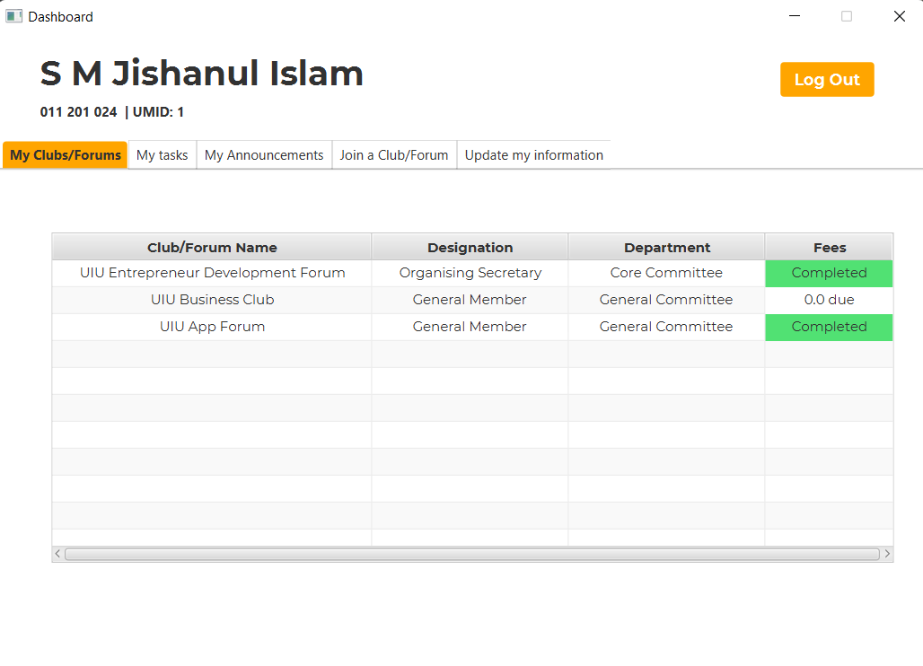
FOR STUDENTS
Student DashBoard

Slide 10
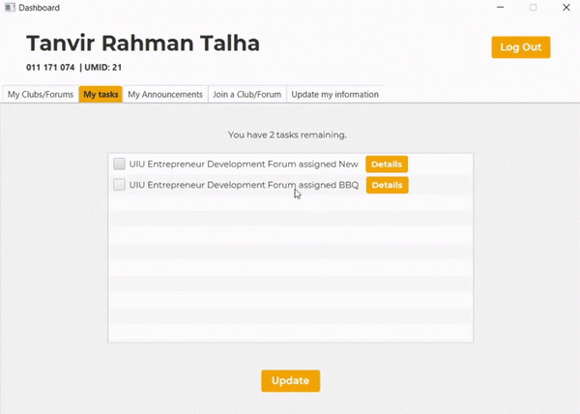
TASK ASSIGNMENT

Slide 11
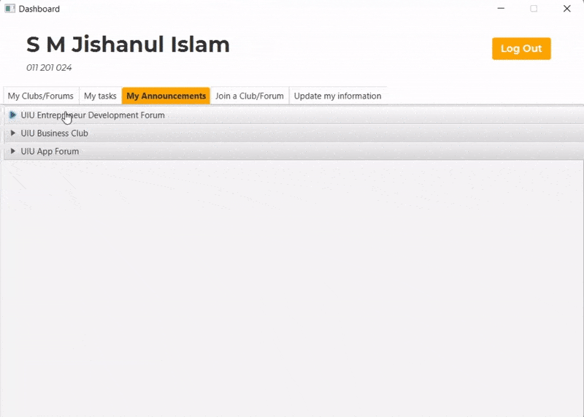

Slide 12
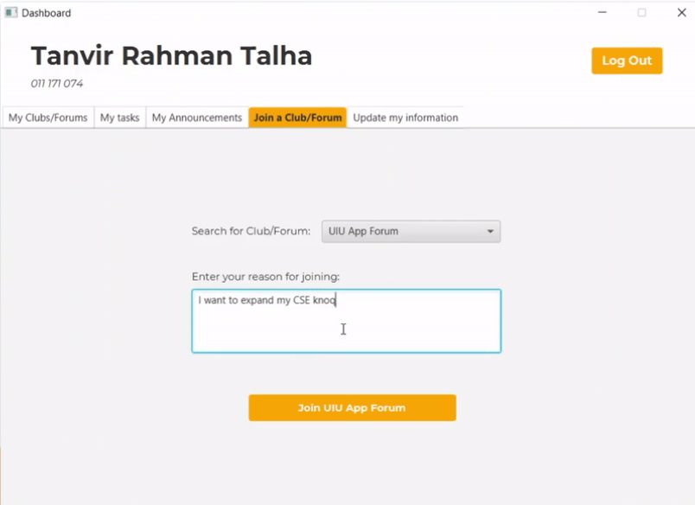
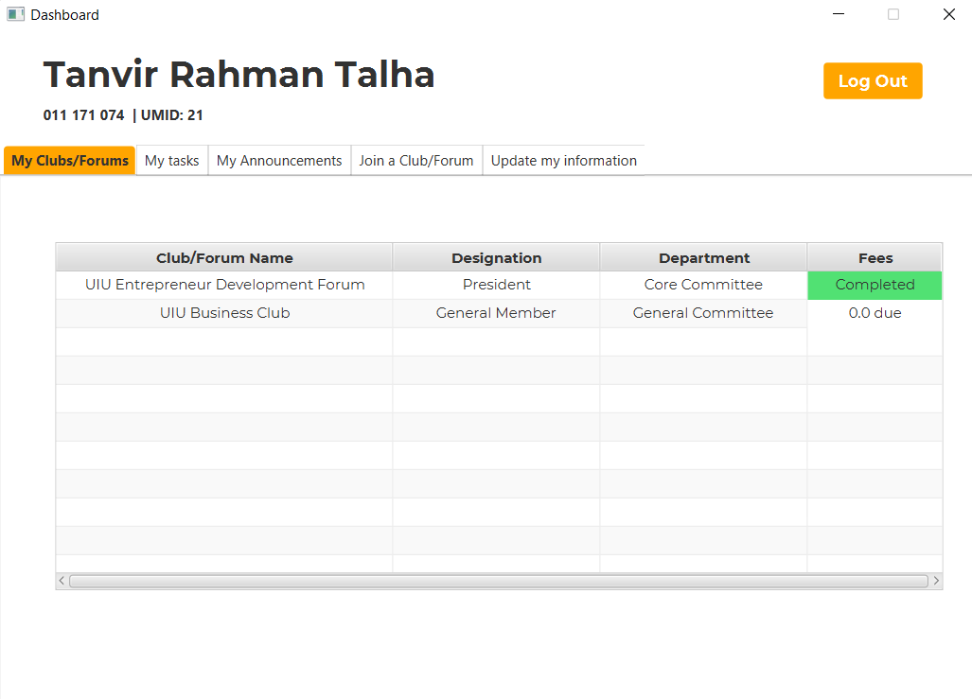

Slide 13
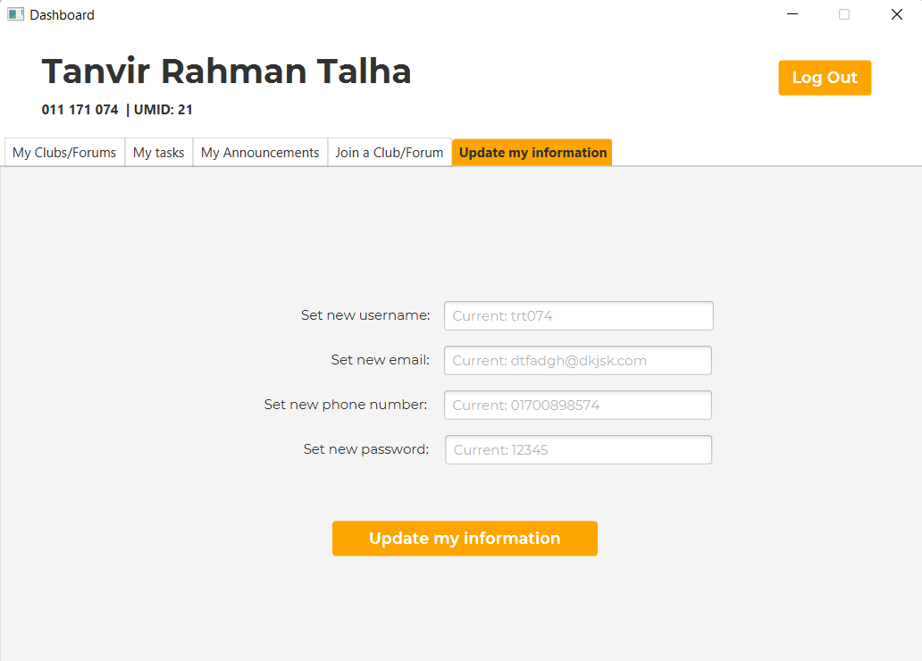

Slide 14
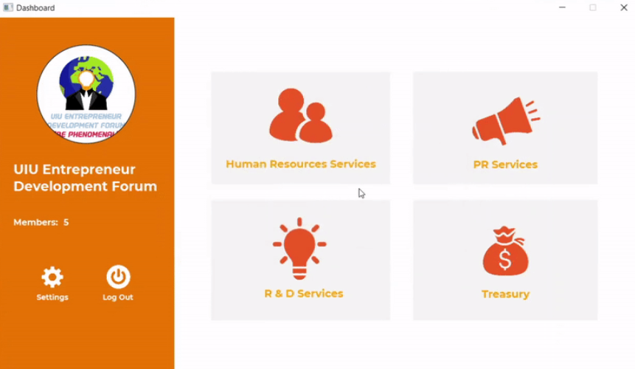
FOR CLUB/FORUMS
*ALL OF THESE ARE PASSWORD PROTECTED
*To manage members
*To send real-time notices
*To check performances
*To manage finances

Slide 15
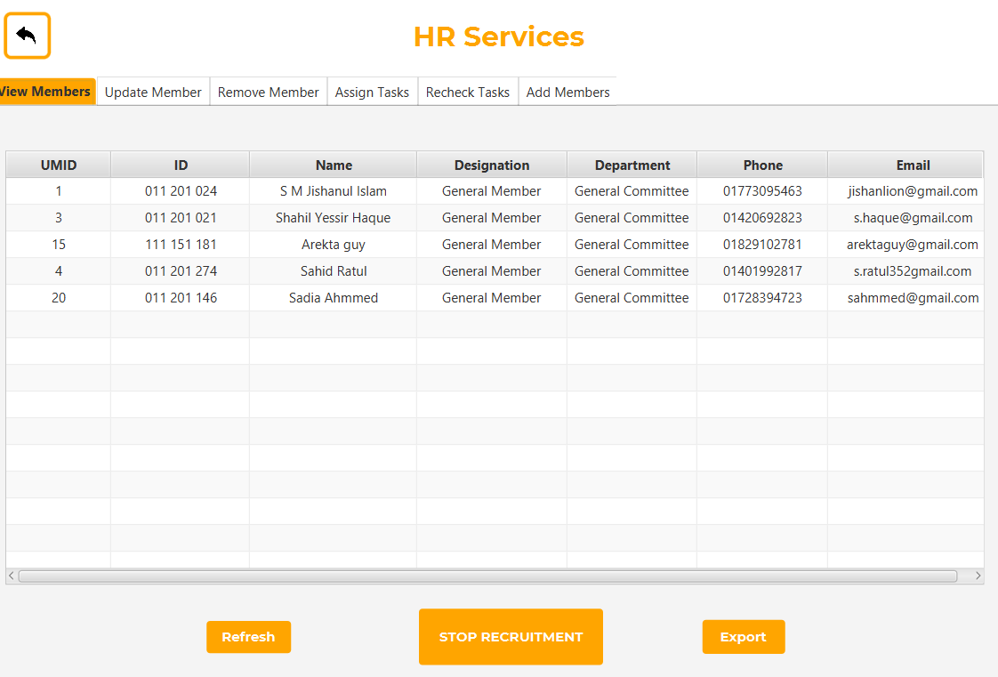
**You can export this table to an Excel file

Slide 16
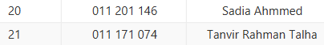
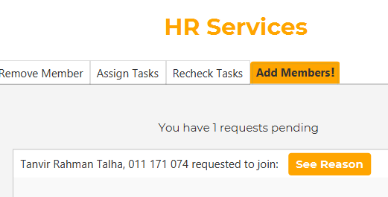
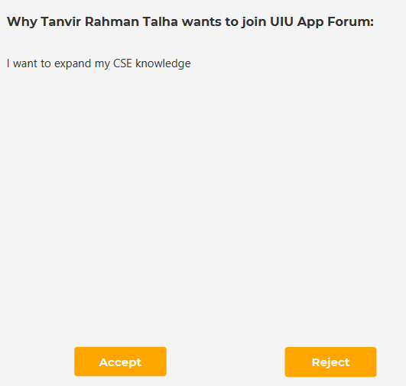
Easy Enrollment Procedure
Student sends an enrol request
Information is updated in real-time along with all updated information
Club/Forum either accepts or rejects it

Slide 17
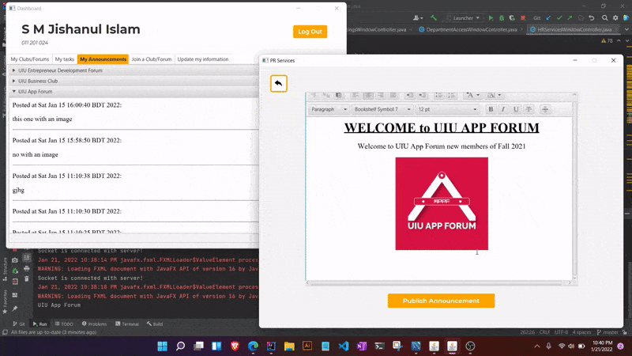
Real-time Announcement System
Announcement published from PR Dashboard
Real time Announcement on Student’s “My Announcement” Dashboard
Instant Push Notification on Desktop

Slide 18
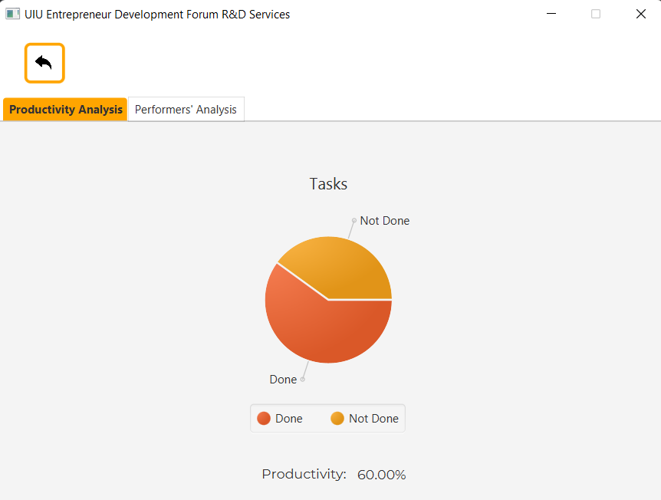
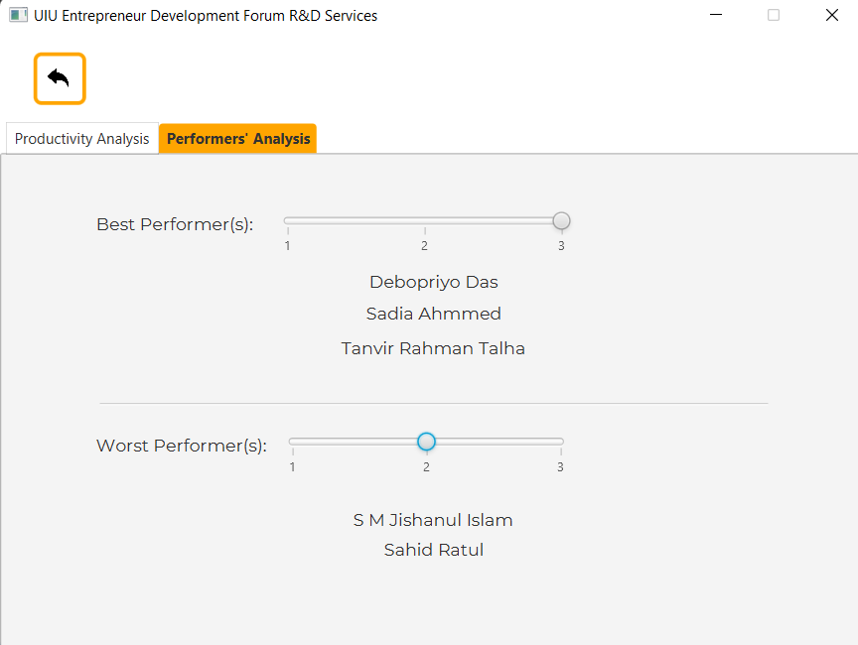
Simplifying R & D
Automated productivity Analysis based on task submissions and performance
Automated Best and Worst Performer Indicators for better analysis of productivity

Slide 19
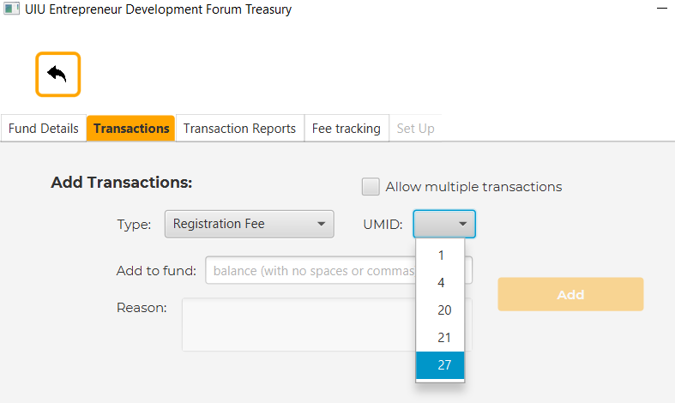
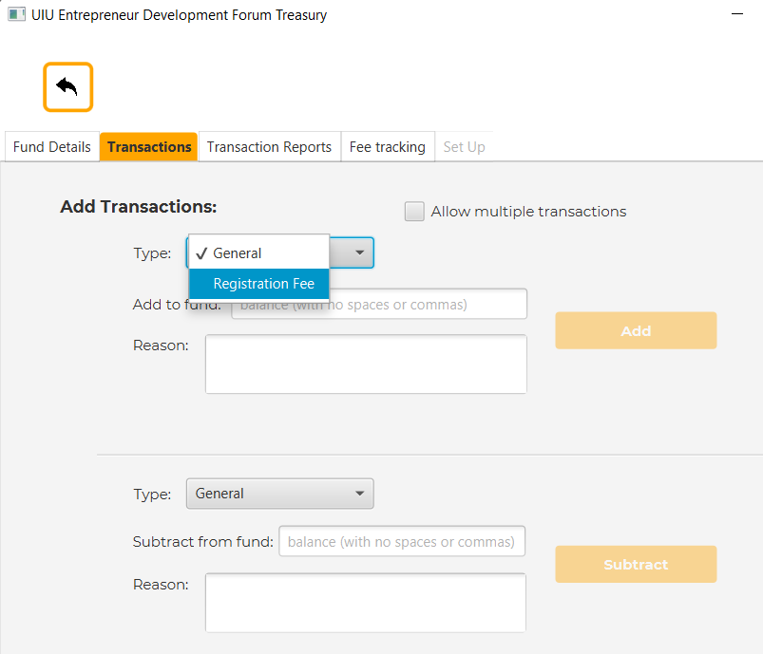
Transaction System
Easy Registration transaction procedure
Step 1: Type Selection
Step 2: UMID Selection

Slide 20
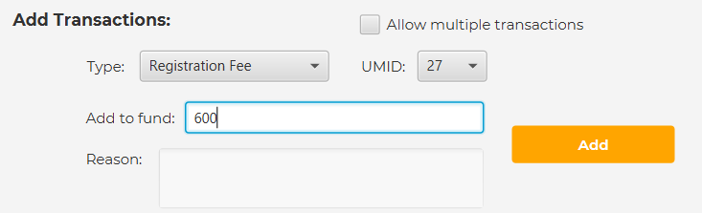
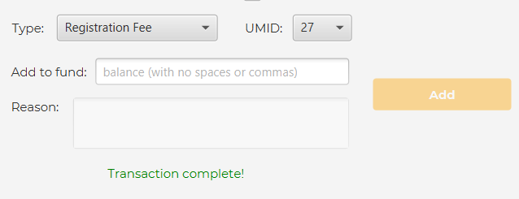
Transaction System
Step 3: Type the amount
Step 4: Click the “Add” button

Slide 21
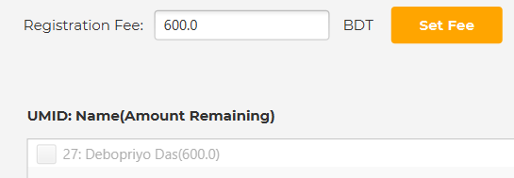
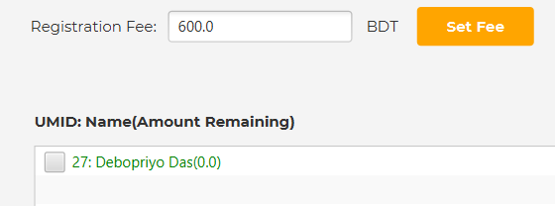
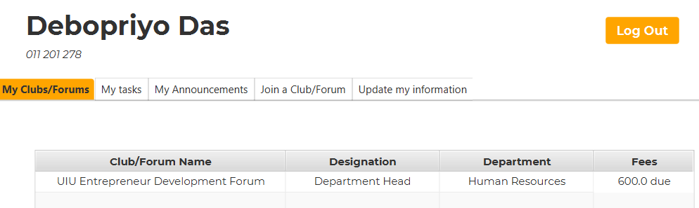
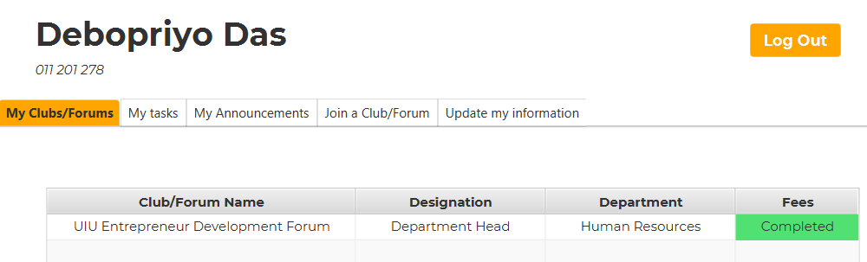
Transaction System
Club/Forum Dashboard
Before Payment
After Payment
In Student Dashboard

Slide 22
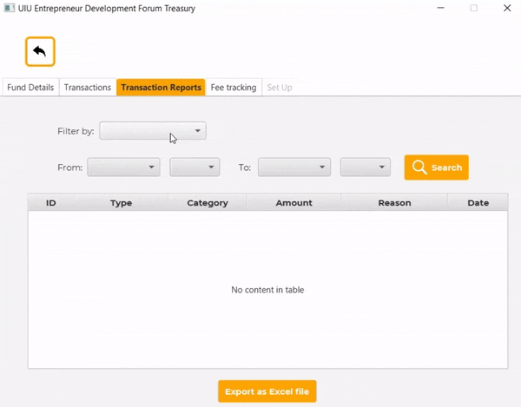
Transaction Filtering System
**You can also export this table to an Excel file

Slide 23
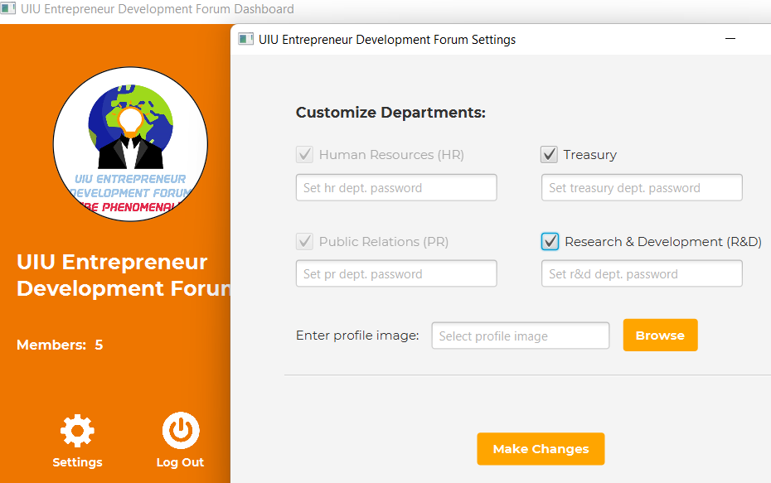
Club/Forum Dashboard Customization
*To update profile pictures and customize the services (whether they want it or not) , Changes happen in real-time

Slide 24
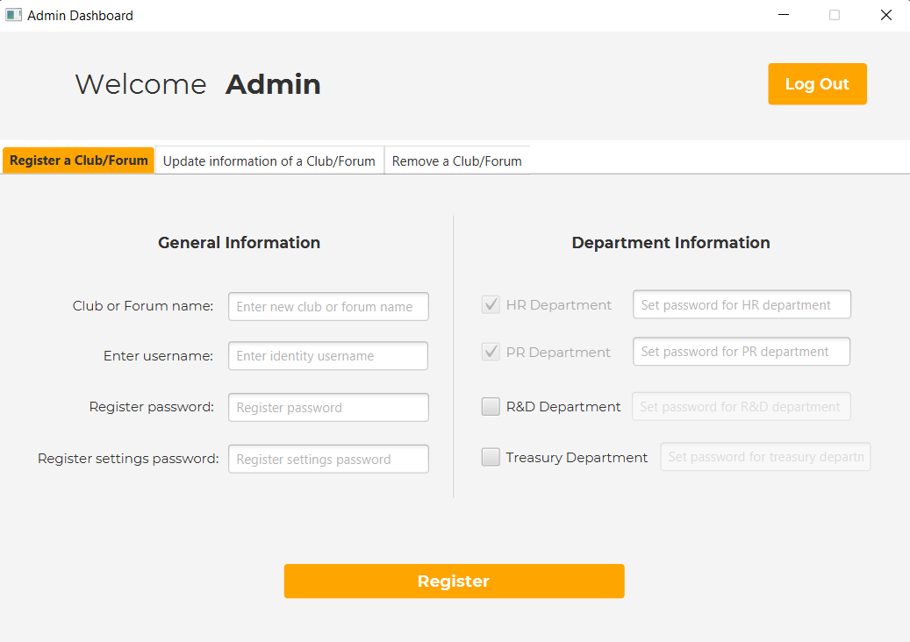
FOR AUTHORITIES
*To create and set passwords of new clubs/forums
*To update their information
*To remove a club/forum

Slide 25





USED TECHNOLOGIES
FRONT END
BACK END
DATABASE
OTHER PACKAGES
TrayTester

Slide 26

THANK
YOU!!!!!
Do you have any questions?

